Slide 1
Attention is all you need
Ajou Univ. software dep. 201920723 김동욱
Kim Dong Wook
NIPS 2017

Slide 2
Transformer ?
RNN
Start
Context
vector
Output 1
Output 2
Output 3
Input 1
Input 2
Input 3

Slide 3
Transformer ?
RNN with attention(seq2seq with attention)
This is SLOW
Start
Score 1
Score 2
Score 3
Context
vector
Output 1
Output 2
Output 3
Input 1
Input 2
Input 3

Slide 4
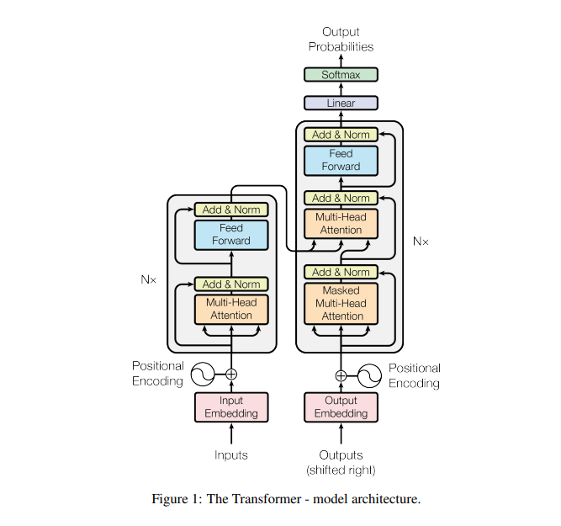
Transformer?
NO RNN, only attention
Use positional encoding

Slide 5
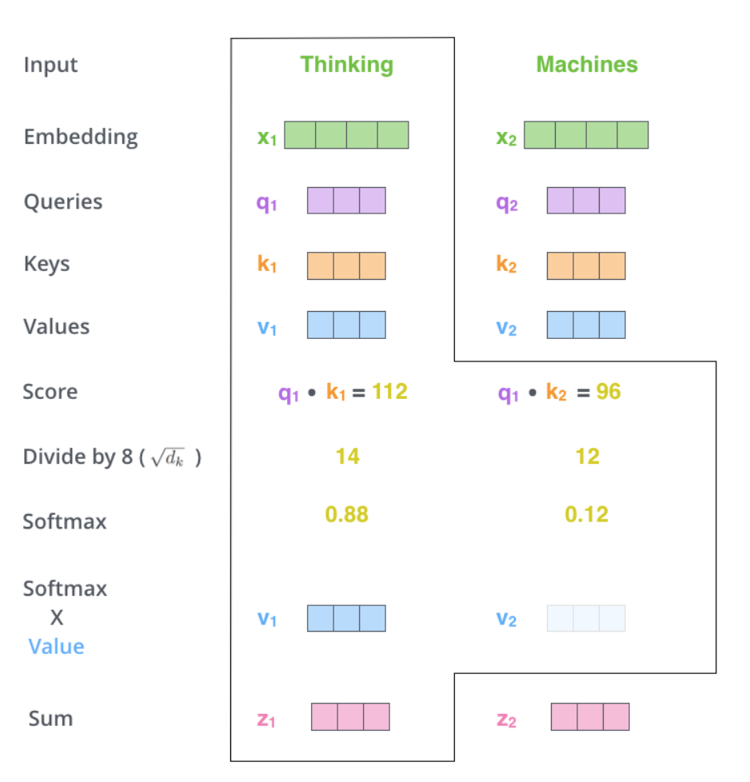
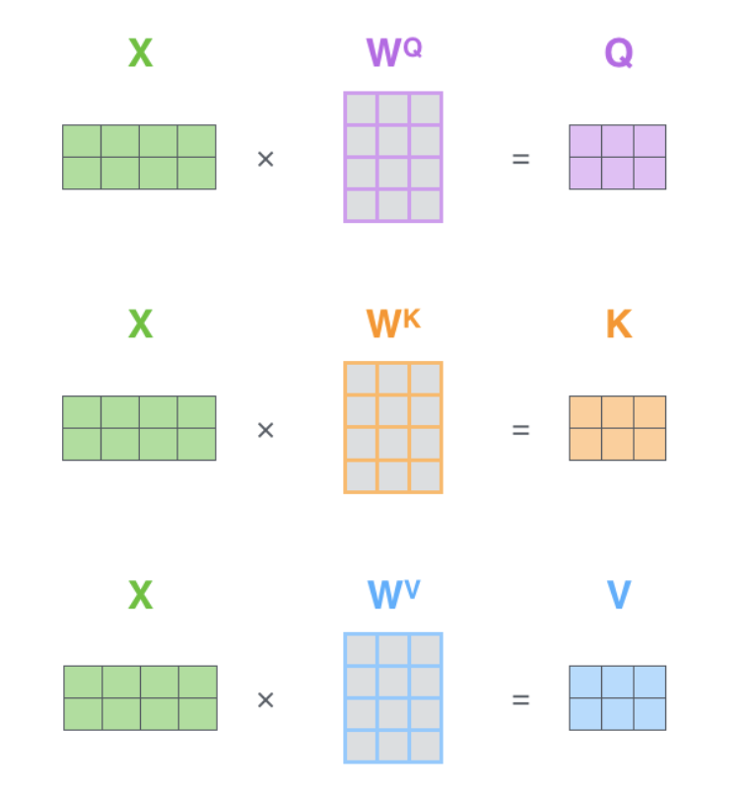
Self Attention

Slide 6
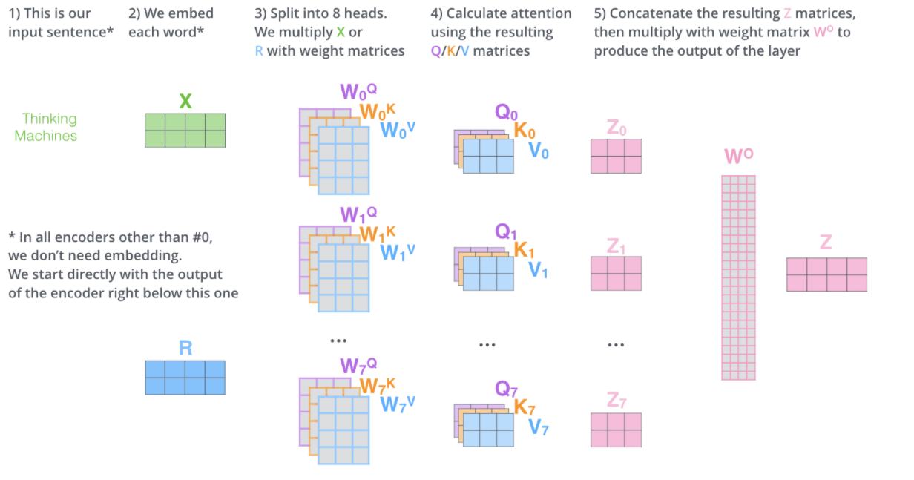
Multi-head Attention

Slide 7
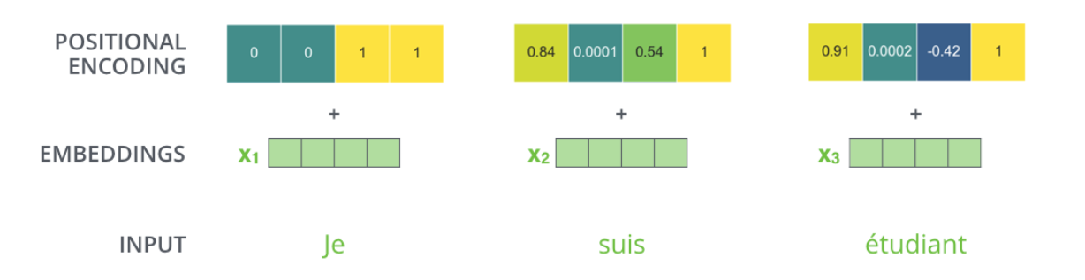
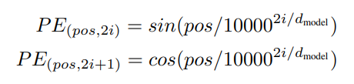
Positional encoding

Slide 8
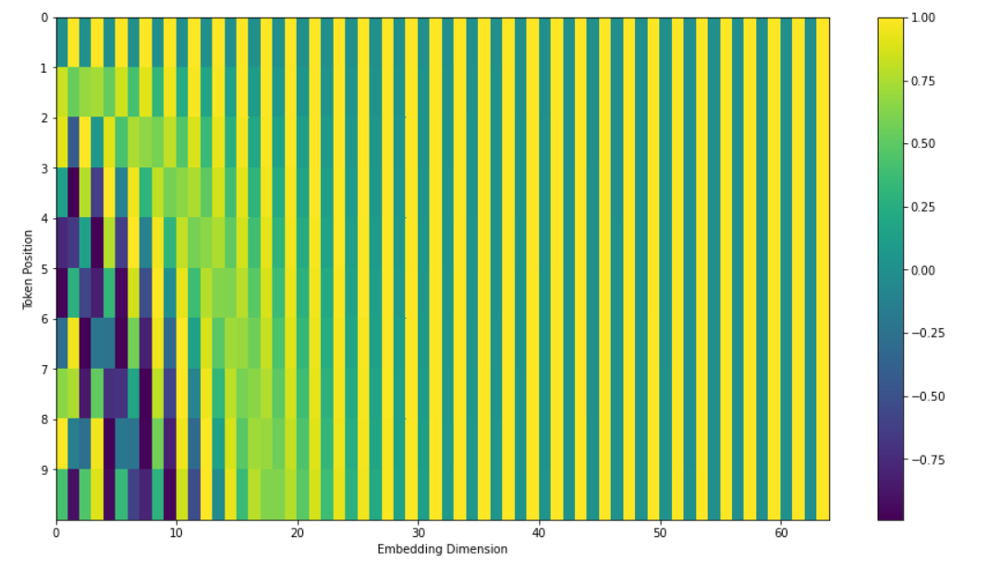
Positional encoding

Slide 9
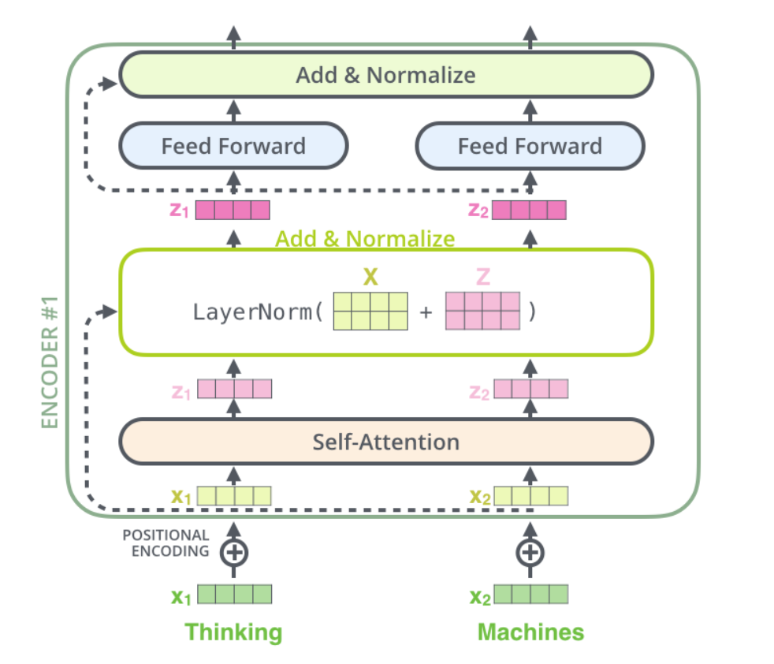
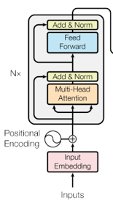
Encoding steps

Slide 10
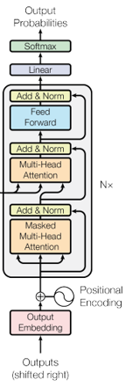
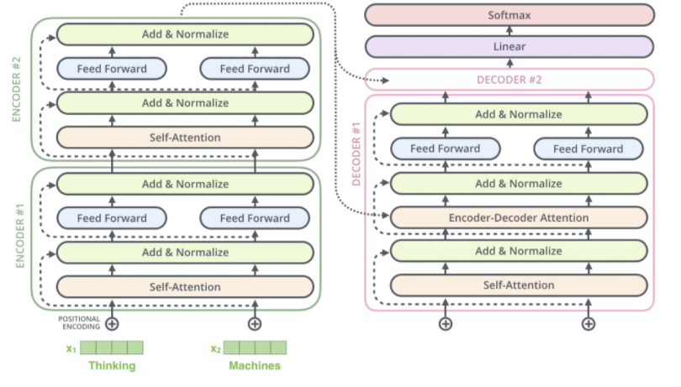
Decoding parts

Slide 11
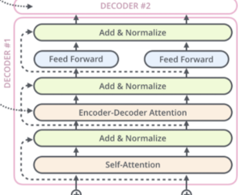
Decoder’s self attention
Masked multi-head attention
Teacher forcing

Slide 12
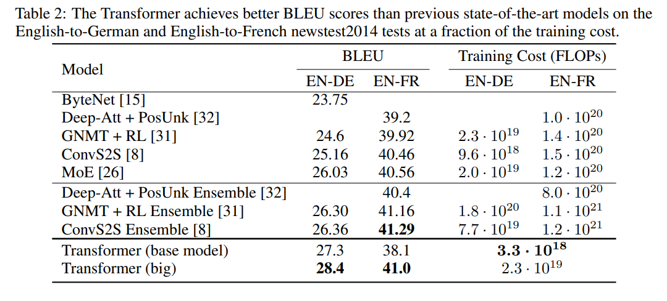
Results

